Slide 1
Mechanism to save medicines from getting wasted
Organisation Name: MindTree
Problem Statement: Mechanism to save medicines from getting wasted
Team Name: Pepehands
Team Leader Name: Harshit Rai
College Code: 1-3508354456
1

Slide 2
Introduction
Tech Stack
According to the researchers of University of Chicago,as much as $5.5 billion dollars worth of unexpired prescription drugs in unopened packs, bottles, and vials are incinerated or tossed in the garbage every year.
Java
Android SDK
Ethereum Virtual Machine
Medicine reuse is still a largely unexplored concept in India and there are very few organized ways to deal with excess medicines.
This project aims at using blockchain to provide a smart, secure and transparent solution to track and reuse medicines.
Solidity
2

Slide 3

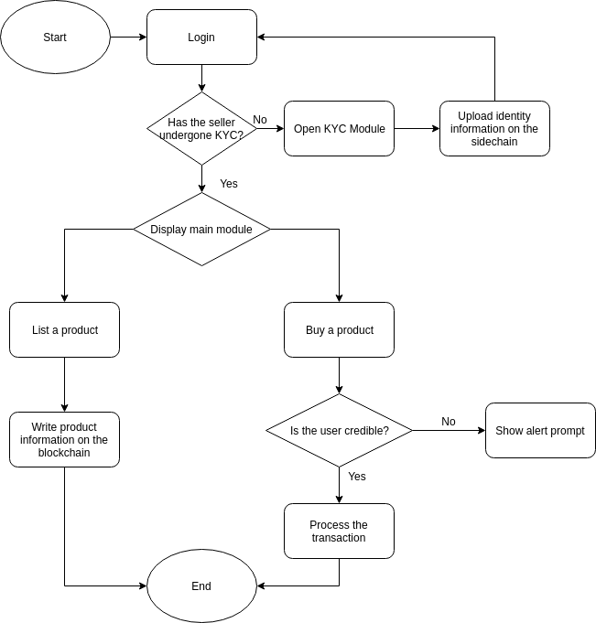
Idea Description
The proposed approach incorporates blockchain for the following reasons:
To keep a track of medicines in supply to identify counterfeit medicines.
Using a sidechain to keep a track of user identities. (Prevent fake users and medicine hoarding).
The users will have to undergo a KYC procedure to verify their individual identities which will be uploaded on a blockchain.
The users can then advertise/request the required medicines on a web portal.
The transactions will be recorded on a public blockchain in order to avoid abuse or resale of medicines within the system.

Slide 4
Use Cases
To provide expensive medication free of charge to economically underdeveloped people.
To provide reliable and transparent supply chain to NGOs and Charities.
Analyze the medication trends in order to assist with the detection of outbreaks.

Slide 5
Showstoppers
Offer an overall solution to wastage of medications and serve the economically underdeveloped people.
Monitor medicine trends to reactively detect epidemic outbreaks across regions.
Offer a transparent environment by effectively eliminating possibilities of malpractices.

